Slide 1
Graph Traversal algorithms
BFS & DFS

Slide 2
Graph Search
Given: a graph G = (V, E), directed or undirected
Goal: methodically explore every vertex and every edge
Ultimately: build a tree on the graph
Pick a vertex as the root
Choose certain edges to produce a tree
Note: might also build a forest if graph is not connected
There are two standard graph traversal techniques:
Breadth-First Search (BFS)
Depth-First Search (DFS)

Slide 3
Breadth-First Search
“Explore” a graph, turning it into a tree
One vertex at a time
Expand frontier of explored vertices across the breadth of the frontier
Builds a tree over the graph
Pick a source vertex to be the root
Find (“discover”) its children, then their children, etc.

Slide 4
Breadth-First Search
Again will associate vertex “colors” to guide the algorithm
White vertices have not been discovered
All vertices start out white
Grey vertices are discovered but not fully explored
They may be adjacent to white vertices
Black vertices are discovered and fully explored
They are adjacent only to black and grey vertices
Explore vertices by scanning adjacency list of grey vertices

Slide 5
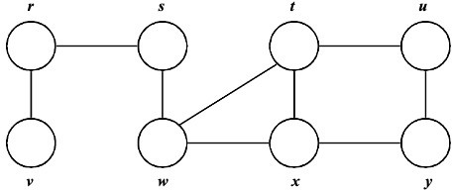
BFS – Example

Slide 6
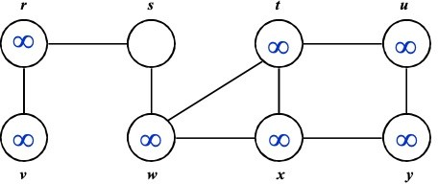
BFS – Example

Slide 7
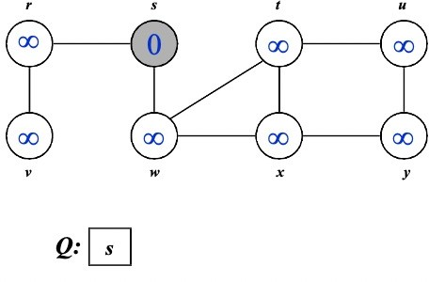
BFS – Example

Slide 8
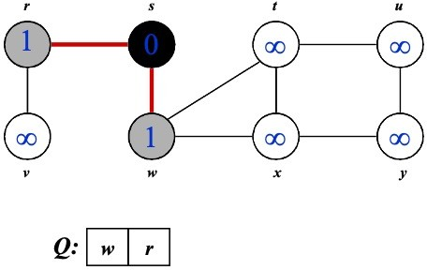
BFS – Example

Slide 9
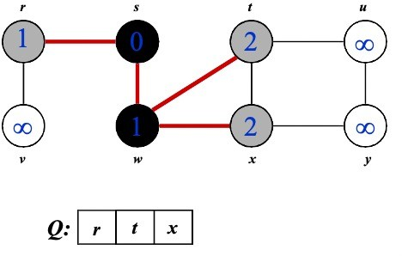
BFS – Example

Slide 10
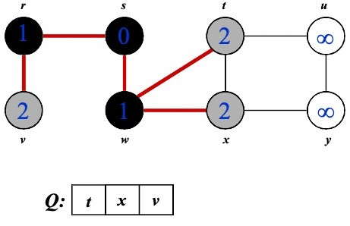
BFS – Example

Slide 11
BFS – Example

Slide 12
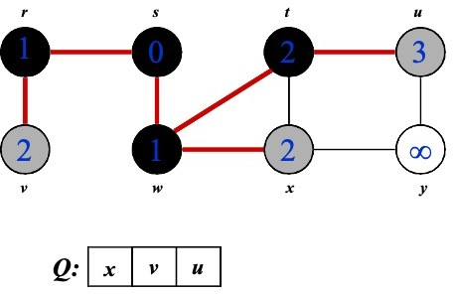
BFS – Example

Slide 13
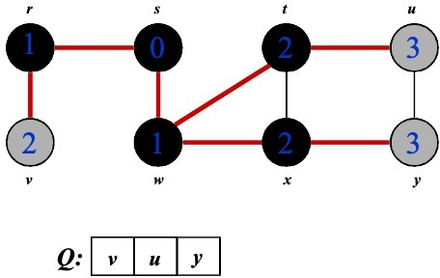
BFS – Example

Slide 14
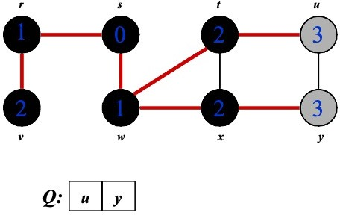
BFS – Example

Slide 15
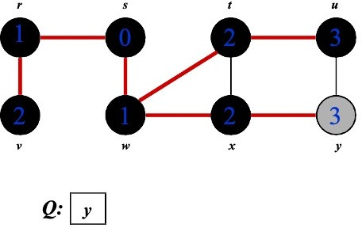
BFS – Example

Slide 16
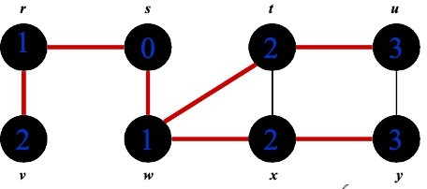

BFS – Example

Slide 17
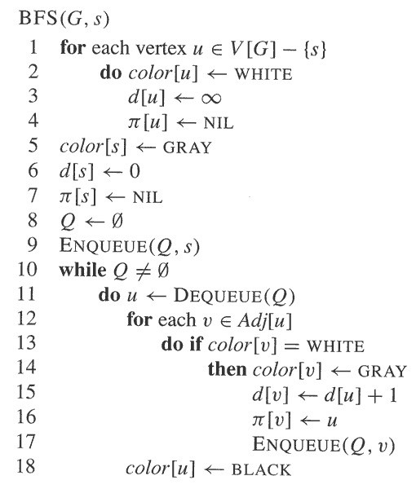
BFS – Code
BFS(G, s) {
initialize vertices;
Q = {s};
while (Q not empty) {
u = RemoveTop(Q);
for each v ∈ u->adj {
if(v->color == WHITE)
v->color = GRAY;
v->d = u->d + 1;
v->p = u;
EnQueue(Q,v);
}
u->color = BLACK;
}

Slide 18
Depth-First Search
Depth-first search is another strategy for exploring a graph
Explore “deeper” in the graph whenever possible
Edges are explored out of the most recently discovered vertex v that still has unexplored edges
When all of v’s edges have been explored, backtrack to the vertex from which v was discovered
Vertices initially colored white
Then colored gray when discovered
Then black when finished

Slide 19
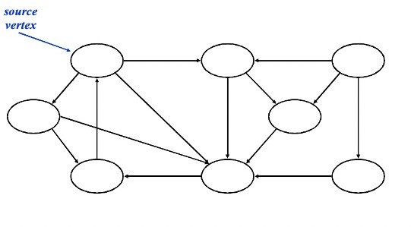
DFS - Example

Slide 20
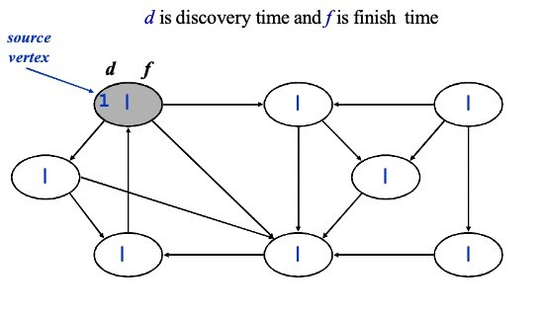
DFS - Example

Slide 21
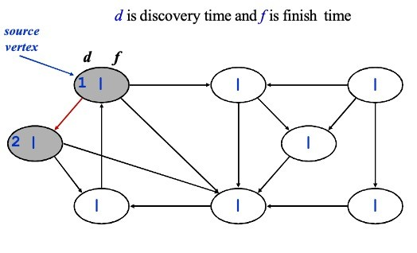
DFS - Example

Slide 22
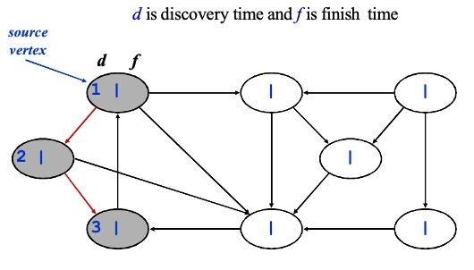
DFS - Example

Slide 23
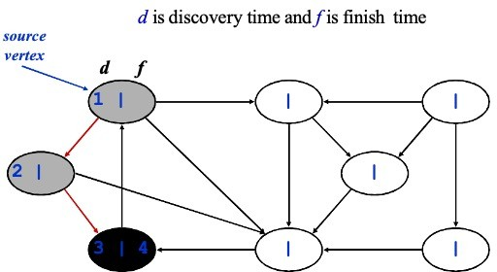
DFS - Example

Slide 24
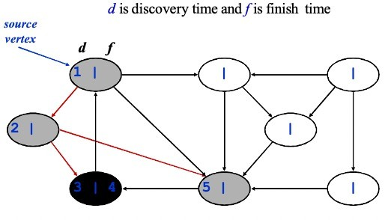
DFS - Example

Slide 25
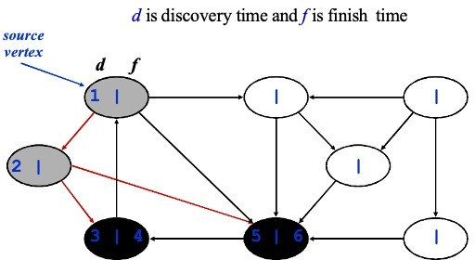
DFS - Example

Slide 26
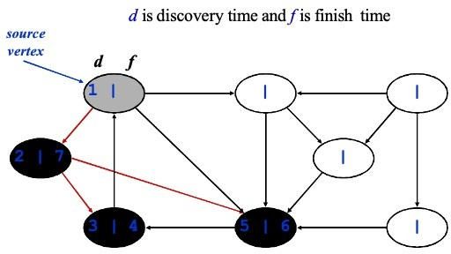
DFS - Example

Slide 27
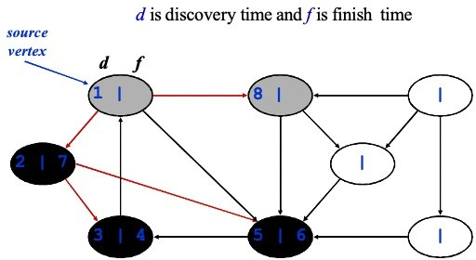
DFS - Example

Slide 28
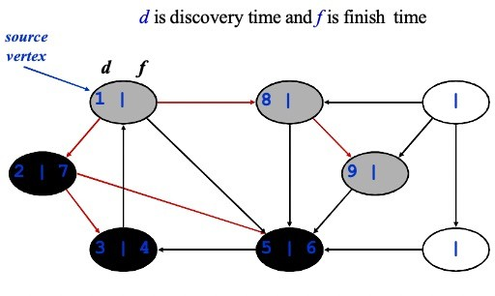
DFS - Example

Slide 29
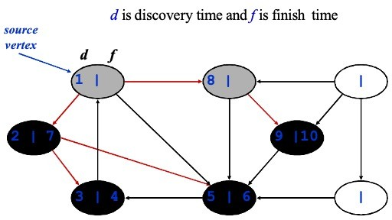
DFS - Example

Slide 30
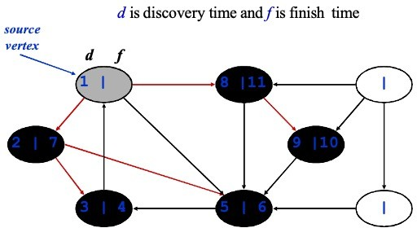
DFS - Example

Slide 31
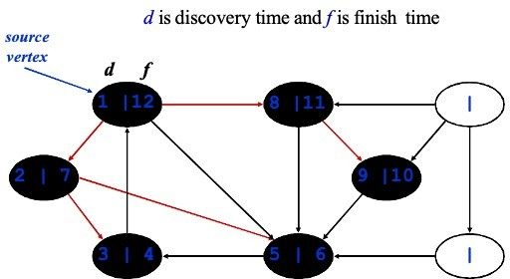
DFS - Example

Slide 32
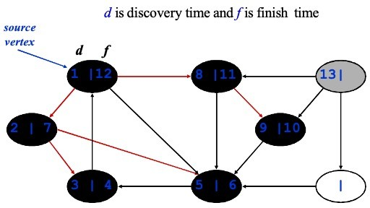
DFS - Example

Slide 33
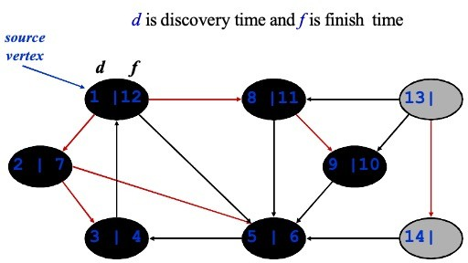
DFS - Example

Slide 34
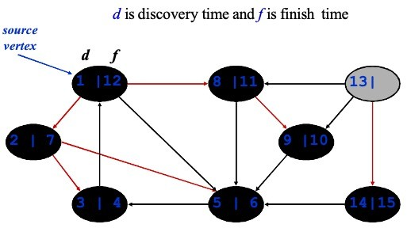
DFS - Example

Slide 35
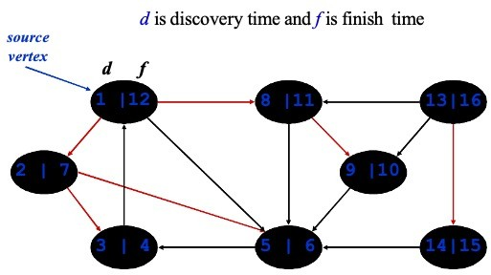
DFS - Example

Slide 36
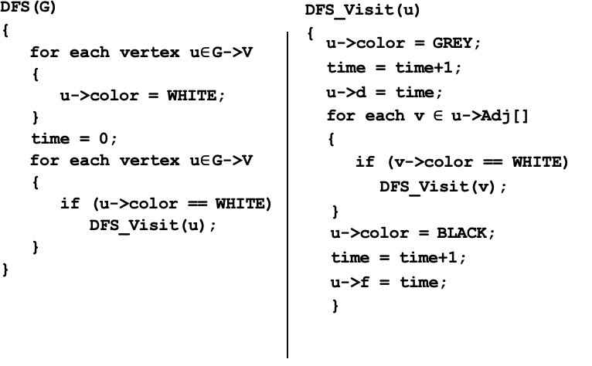
DFS – Code

